Slide 1

Usablity
Sagor Saha
21-45074-2
American International University – Bangladesh
Dept. CSE

Slide 2
Affordance
1. Visibility
2. Mapping​
3. System Image
4. Gulf Execution
5. Gulf Evaluation

Slide 3
Affordance

Slide 4
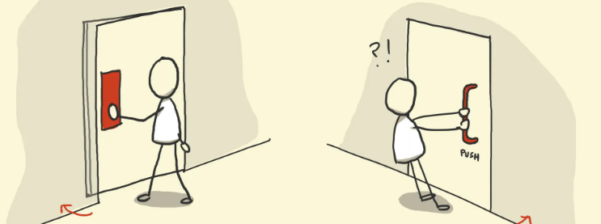
Affordance
Affordance refers to the way someone can use an object. In design, affordance ensures that users intuitively understand how to interact with an object based on its appearance.

Slide 5
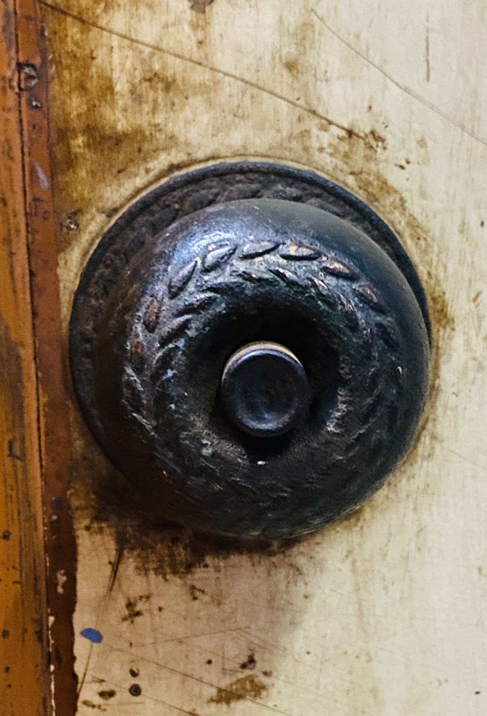
Affordance issue with-door handle
A round knob is used on a door that should be pushed open, which confuses users about whether to twist, pull, or push. The round knob suggests turning (a twist action) instead of pushing. A flat plate or bar would afford pushing more naturally, aligning with the intended action.

Slide 6
visibility

Slide 7
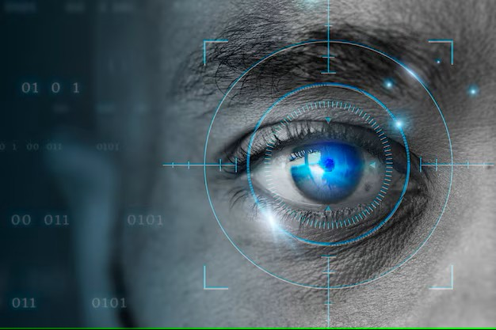
visibility
Visibility refers to how easily users can see and understand the available controls, features, or options in a system or object.

Slide 8
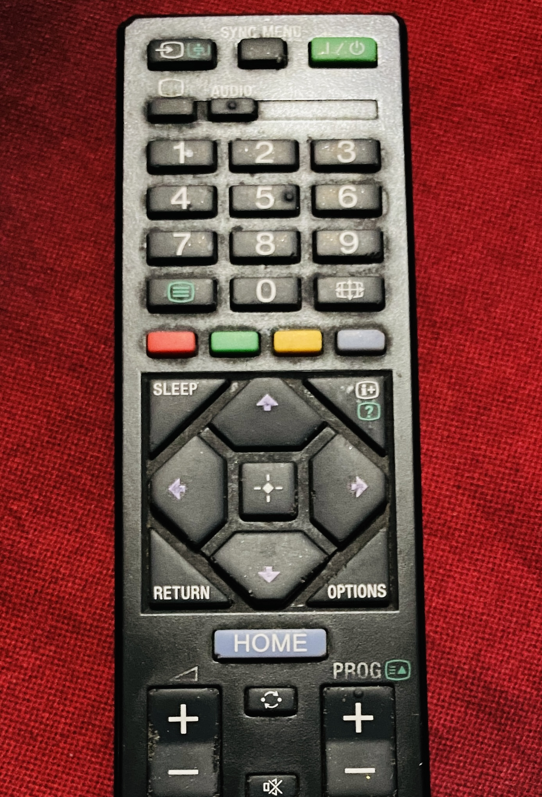
visibility issue with-tv remote
Important buttons like "Settings" or "Menu" are small, hidden, or placed alongside less-used buttons, making them hard to identify. The design doesn't make these critical controls stand out, forcing users to search or guess.

Slide 9
mapping

Slide 10
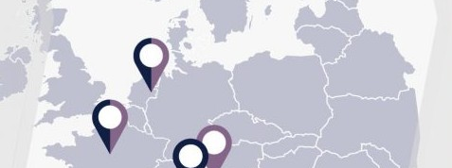
mapping
Mapping refers to the relationship between controls and their effects in the real world. A good mapping ensures that users can predict the outcome of their actions intuitively, based on the control's design and placement.

Slide 11
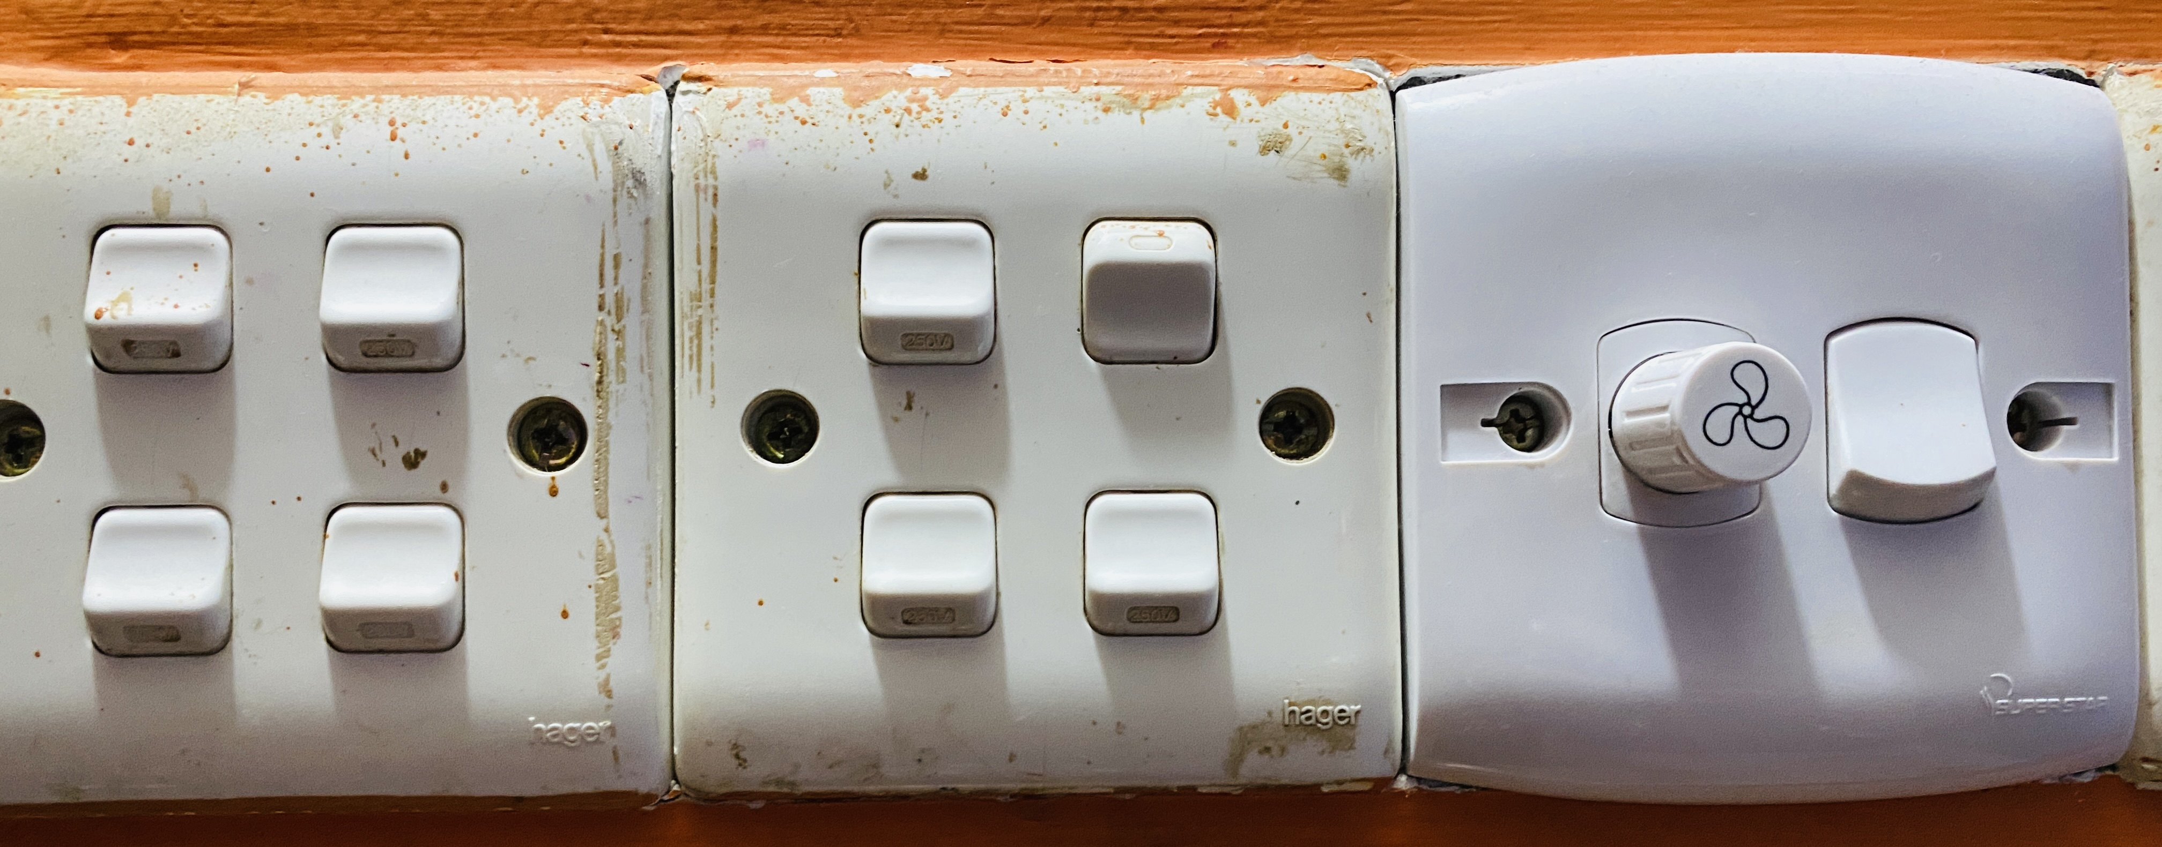
Mapping issue with-Light Switches
A row of switches controls multiple lights, but there's no indication of which switch corresponds to which light. The lack of logical mapping between the switches and their respective lights causes trial-and-error operation, reducing efficiency and increasing user frustration.

Slide 12
System image

Slide 13
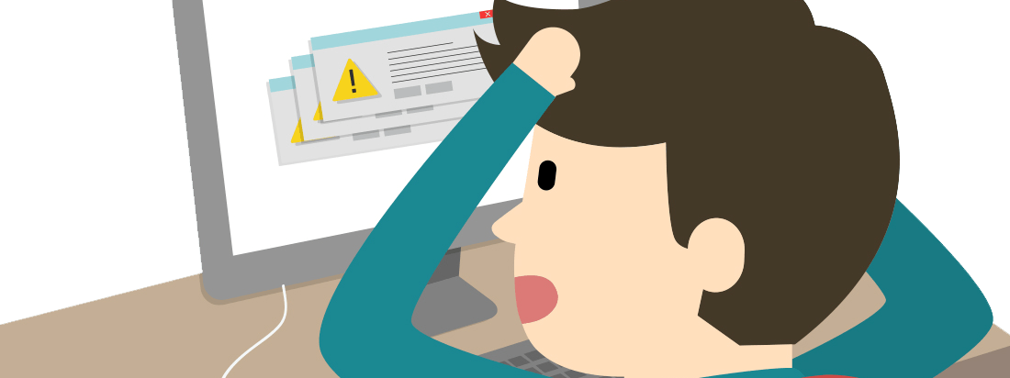
System image
A System Image Issue occurs when the design of an object or system fails to clearly convey its functionality, purpose, or how it should be used. The system image is essentially the representation of the system as perceived by the user, including the physical design, labels, instructions, and icons. If the system image is unclear, users may struggle to understand how to interact with the system effectively.

Slide 14
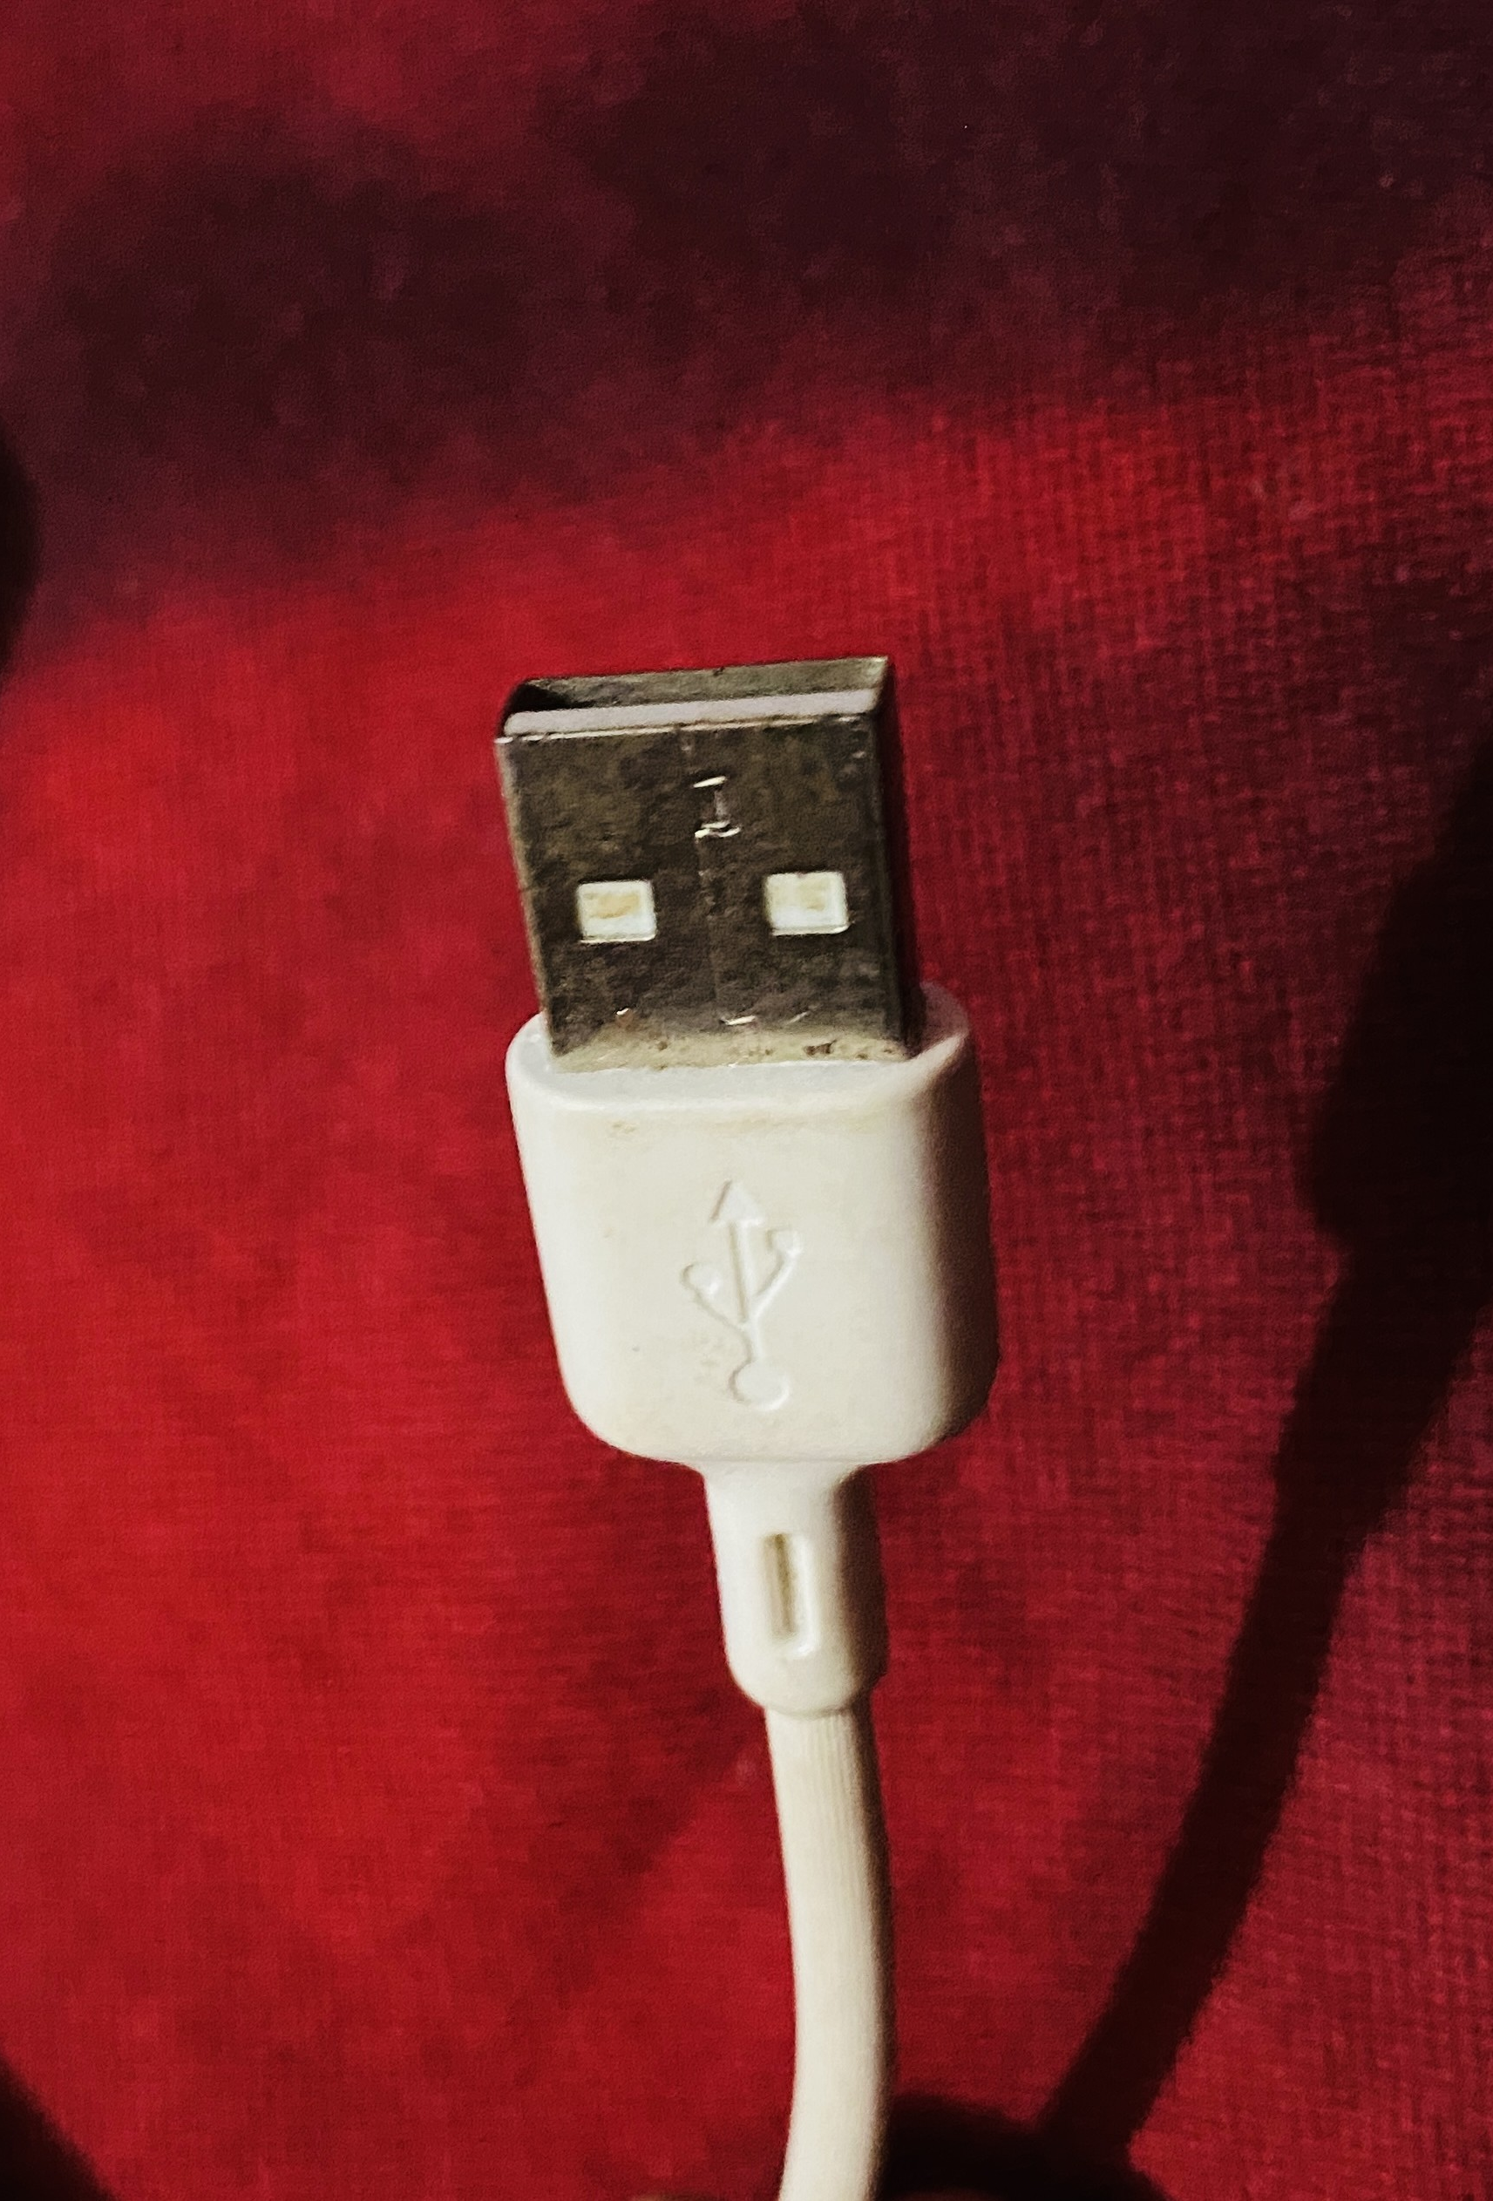
System image issue-usb cable
It’s hard to tell which side of the USB plug is "up" or "down," often resulting in multiple attempts to insert it correctly. The design of the cable fails to visually or physically convey its correct orientation, leading to confusion and user frustration.

Slide 15
Gulf Of Execution & Gulf of Evaluation

Slide 16
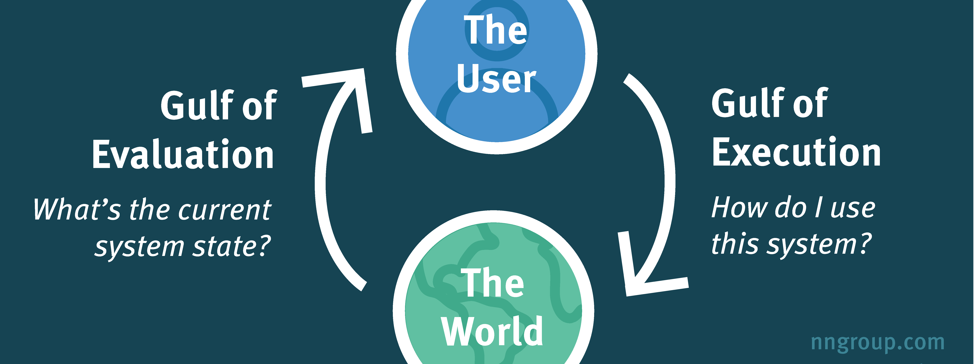
Gulf of evaluation and gulf of execution
Gulf of Execution and Gulf of Evaluation are key concepts in Human-Computer Interaction (HCI) that describe the gaps between what users want to do, how they can do it, and how well they can assess the outcomes.

Slide 17
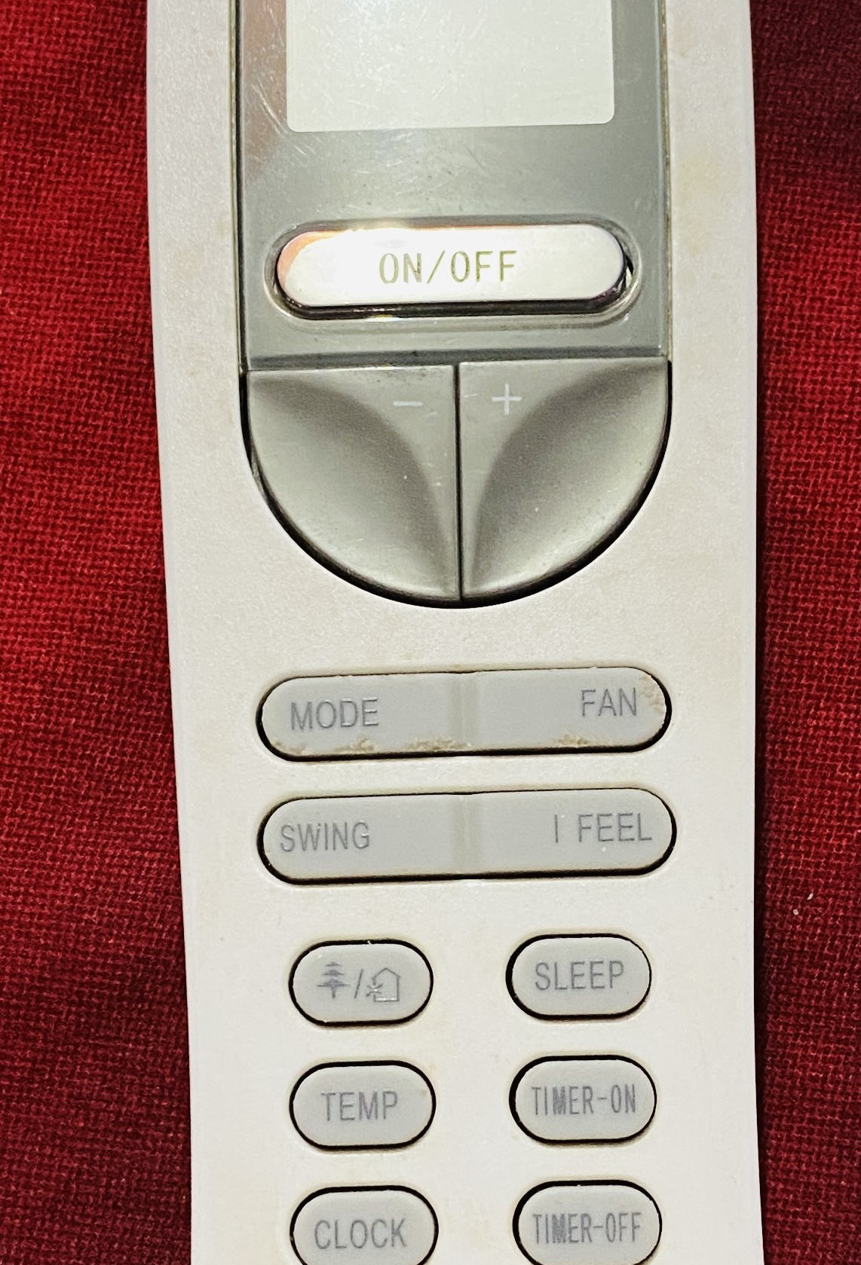
Gulf Of Evaluation & Execution issue with Air Conditioner Remote
The remote’s interface is overloaded with buttons and unclear icons, making it hard to know how to set specific modes or temperatures. Users struggle to translate their intent (e.g., setting a mode or temperature) into actions because the design doesn’t provide clear guidance.

Slide 18
Thank you
Sagor Saha
21-45074-2

